Slide 1
BOOKBOT Website Planning Slides
Amrita – Our main aim is to get the website structure ready on WIX asap.
Tuesday after the interview session we can tweak the wordings/content and images and font – we can get each others view point in tomorrow meetings

Slide 2
LOGO
HOME DIRECTORY ABOUT US VIDEOS BLOG FAQ
BANNER
INTRODUCING KID’S LEARNER GARDEN BOOKBOT
WATCH: PARENTS AND CHILDREN LOVE BOOKBOT
https://youtu.be/2JZSzvOI1EM
HEADINGS/SLOGAN
PLAY VIDEO
Step 1: Add a chat plugin to your website to connect with your visitors.
Step 2: Create custom chatbots that answer questions or collect feedback.
Step 3: Close more sales and track how chatbots help your business.
ONLINE PHONIC GAMES THAT KIDS WILL LOVE!
https://assets.readingeggs.com/mkt/fastphonics/videos/AU/au-fast-phonics-parents-overview-jun2020.mp4
Turn Any Kid's Book Into an Audio Book
REC
CHAT BOT
INTERACTIVE LEARNING GAME
PARENT’S VOICE RECORDING

Slide 3
SEND US FEEDBACK
Star rating for app and/or book - user feedback can be given
READ OUR BLOG
(on blog slide)
FOOTER
(on footer slide)

Slide 4
FEATURES:
CHAT BOT
Step 1: Add a chat plugin to your website to connect with your visitors.
Step 2: Create custom chatbots that answer questions or collect feedback.
Step 3: Close more sales and track how chatbots help your business.
DIRECTORY: quick search option for finding book of their choice (searching for the books will be the next step)
SHORT STORIES VIDEOS - Check Ana’s docs, this feature comes under VIDEO page on menu bar
IMAGES- Check Ana’s docs
INTERACTIVE LEARNING GAME: ONLINE PHONIC GAMES THAT KIDS WILL LOVE!
https://assets.readingeggs.com/mkt/fastphonics/videos/AU/au-fast-phonics-parents-overview-jun2020.mp4
Also Details Given below
PARENT’S VOICE RECORDING: “Turn Any Kid's Book Into an Audio Book”. NEED A PLUGIN FOR THIS FEATURE
Star rating for app and/or book - user feedback can be given
Compatible on desktop, android phone

Slide 5
Interactive phonics games that really work!
Fast Phonics is an online synthetic phonics program that helps children become strong readers.
The program includes 20 fun‑filled levels where children learn key phonics skills including letter‑sound recognition, blending and spelling. Each level is a Mountain Peak covering one set of letters with more than 20 exciting activities.
IMAGES OPTIONAL/USE OWN IMAGES
https://readingeggs.com.au/images/fastphonics/peak1-world.jpg
https://readingeggs.com.au/images/fastphonics/peak-progress.jpg
https://readingeggs.com.au/images/fastphonics/peak1-stones.jpg
httphttps://readingeggs.com.au/images/fastphonics/fast-phonics-animated-teaching-videos.pngs://readingeggs.com.au/images/fastphonics/students-of-all-ages.png
https://readingeggs.com.au/images/fastphonics/fast-phonics-interactive-games.png
https://readingeggs.com.au/images/fastphonics/fast-phonics-decodable-books.png
https://readingeggs.com.au/images/fastphonics/fast-phonics-assessment-reporting.png
https://readingeggs.com.au/images/fastphonics/peak5-book-quiz.png
https://readingeggs.com.au/images/fastphonics/fast-phonics-printable-resources.png
https://readingeggs.com.au/images/fastphonics/fast-phonics-rewards.png
Why children love Fast Phonics games
Fast Phonics is perfect for children aged 5–10 who are just learning to read, as well as older children who are struggling at school. The highly engaging phonics games combined with motivating rewards keep kids on track and eager to improve their skills.

Slide 6
Fast Phonics includes dozens of animated videos.
Entertaining learning videos reinforce systematic synthetic phonics instruction. Letter-sound videos incorporate powerful visual mnemonics (visual memory aids) – proven to boost letter‑sound recognition.
Fast Phonics includes hundreds of highly engaging interactive activities.
Children practise key phonics skills including letter‑sound recognition, blending all through the word, spelling skills, nonwords, syllables, reading captions and extended text.
Fast Phonics includes dozens of decodable books.
Beautifully illustrated decodable books are embedded within each peak. Your child will complete a comprehension quiz after reading each book.
Fast Phonics includes assessment and reporting.
Regular quizzes assess phonics skills and track your child's progress.
Fast Phonics includes hundreds of printable worksheets.
The bank of printable resources includes easy‑to‑follow worksheets and handwriting pages for each peak, so your child can practise key phonics skills offline.
Fast Phonics is fun and motivating. Children love it!
Exciting rewards ensure children are engaged and motivated to keep learning. Playful characters, including a fun Yeti avatar, and exciting upgrades, collectable gems and Yeti coins, make Fast Phonics fast fun each step of the way.

Slide 7


Bookbot
Hello, my name is Oliver!
Join me in my learning adventure!

Slide 8
Footer Conent
© Bookbot Pty Ltd 2019
All Rights Reserved
Social media icons - only tabs no need to link it to anywhere
Notes:
No need to add links i footer for each page as in Boobot website
I wasn’t able to remove the highlight - Sarah please just add the copyright wordings as in Bookbot website without any logo image.

Slide 9
Features
This is additional page – to be added in Menu bar .
Content, videos, can be edited in blocks later
Please suggest any ideas any of below features can be added
1. Chat Bot (24/7) (Can go on bottom section of home page/last page ?)
2. Directory - quick search option for finding book of their choice
3. Images to attract kids to browse easily in app
4. Short story videos clip for those who don’t wish to read books
5. Parent’s voice recording - short story for kids to listen to
6. Interactive learning game feature (reading egg)
7. Star rating for app and/or book - user feedback can be given
8. Compatible on desktop, android phone

Slide 10
Add Oliver on top at corner with slogan
Let your imagination explore, Read more
Fun Stories for Kids (who love to read books by listening)
A fun and unique videos designed for pre-K through elementary aged children and their families to experience popular story books.
Each story is entertaining and educational, and includes a great children’s story narrated by a master storyteller,
https://www.youtube.com/watch?v=zPA5hWu7jIo
https://www.youtube.com/watch?v=UPO7P1gHAmo
https://www.youtube.com/watch?v=x-Bpoj5fZr0

Slide 11
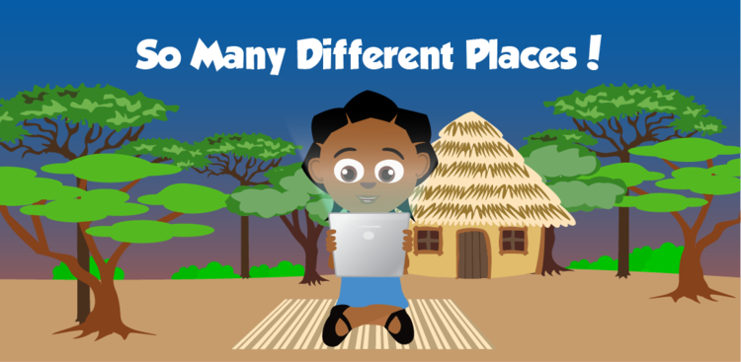
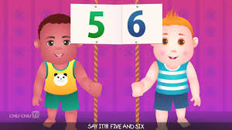
Interactive learning game feature
In our app, interactive game features are designed to empower children in fun, self-guided learning through exploration and curiosity.
Download any of these great learning games for free..
Read With Oliver - So Many Different Places
Join Oliver in visiting different places and finding a world of
wonderful things in this interactive storybook!
Explore words, pictures, and ideas through different interactive features.
Chinku
Chinku is a gamified, personalized and adaptive learning system which guides a child from absolutely no knowledge of the alphabet to a stage where the child can read to learn and perform basic arithmetic.

Slide 12
About US
Dummy content below (should mainly focus on Mission of the Company (Michelle to help to edit this for us please))
Bookbot is an website that supports your child as they learn to read. When you subscribe to Bookbot, you can download the app and access a library of specially-written ‘decodable’ books. Here’s the magic bit: Bookbot listens to your child as they read the books, helping them as they go.
Bookbot will guide your child through their reading journey. The first time your child accesses Bookbot, they will be asked to complete a screening exercise. This allows Bookbot to select exactly the right level of books for them to start with - it’s important your little reader gets to experience success at the same as learning. If they struggle with a word, Bookbot will highlight it and allow your child to try again or to get Bookbot read it aloud for them. Bookbot will guide your child in this way through the levels until they become confident, independent readers.

Slide 13
Blog
Posts from our Bookbots
Our talented team of creatives, fun-lovers, and magic makers.
Add images and content– should be different from what is in Bookbot (pls add dummy images and content from this link Learning to Read: A Right Not a Privilege | Bookbot (bookbotkids.com))
3 posts enough I feel -?
Notes:
Images and layout – to be recommended by design team, others can share their view too. Put images in folder of Pictures in drive if you find anything good)

Slide 14
Contact US
Simple Form to be added (may be not needed linked with email - its fine)
Sarah - please make it as easy for you - feel free to design this as you like)

Slide 15
FAQ (Can also add – Help and FAQ in heading instead of just FAQ)
Para on to
Please refer to our FAQs below for a range of information about BOOKBOT Library subscriptions, technical queries, user guidelines and other common queries. If you can't find an answer to your question and require technical assistance, please use contact us form. (this should link to contact us page) and we'll respond as quickly as we can.
Subscription FAQ’s
Can more than one child use the subscription?
Yes! You can have multiple profiles within a single subscription. There are different subscriptions which allow a single child or parent reading profile or up to three or eight reading profiles.
If you are a teacher or you are purchasing the app for your school, you can contact us and support team will get in touch with you.
How much does Bookbot cost?
Subscription to Bookbot varies according to how many little readers are using it. Access starts at $8.33 per month (yearly plan) for one user.
Why isn’t Bookbot free?
We have continual running costs such as book writing and illustrating, voice recognition services and app maintenance.
How do I cancel?
It’s easy to cancel your subscription. Just click on Manage Subscription at the bottom of our web page.
Technical FAQ’s
How do I redeem a gift voucher?
If you have a gift voucher that you would like to apply to an existing Story Box Library account, please get in touch with the voucher token and the email address of the account you want to apply it to.
User Guidelines
Pdf file link – to ask on Tuesday in Interview questions
Notes:
Exact questions and answers content can be edited later –above is dummy content to be added.
Font can be chosen – what looks good by developer/designer.

Slide 16
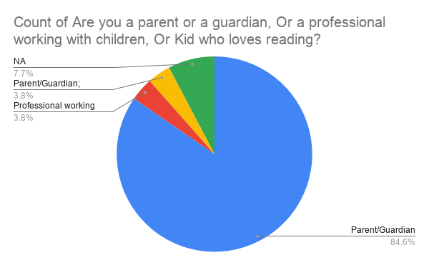
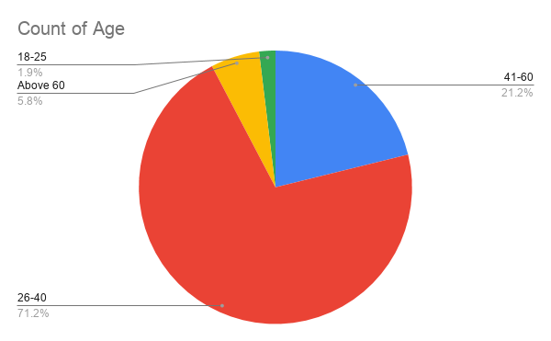
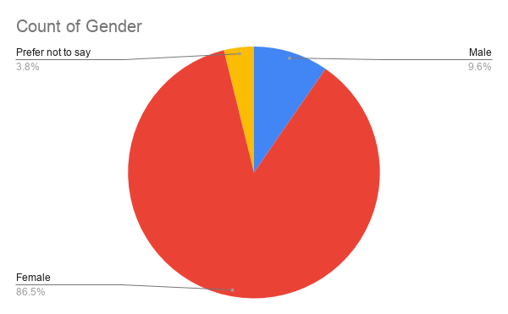
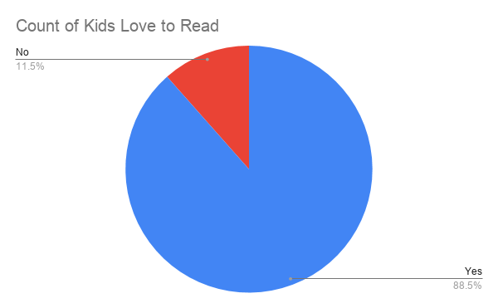
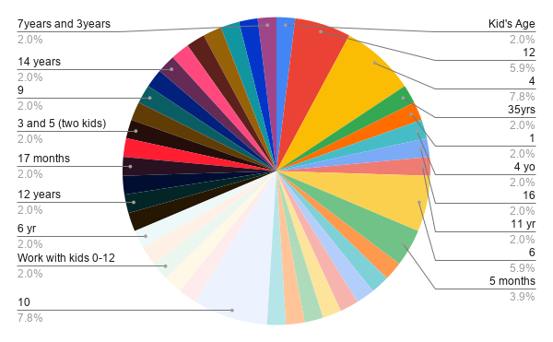
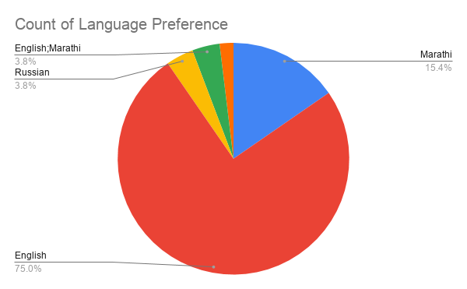
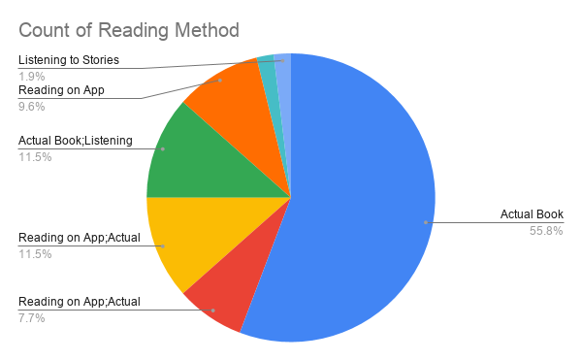
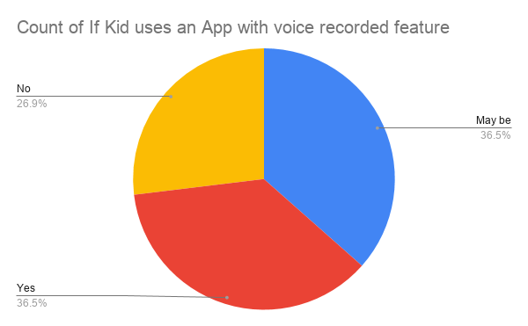
RESPONSES FROM THE SURVEY
KID’S AGE

